Slide 1
An XML version of Turkish Dictionary
Emrah Özcan

Slide 2
Me, Myself and I
My name is Emrah
I am a research assistant @ Yıldız Technical University, ELT Dept.
And doing my PhD @ Ankara Uni., Linguistics Dept.
My background is English Language Teaching but I like to work with many disciplines; Computer Science, Linguistics, Teaching etc.

Slide 3
Me, Myself and I
I did my MA on teaching Turkish as a foreign language
My MA thesis focused on a multilingual dictionary model for foreign language learners and developed a semi-automatic word matching database structure for this specific purpose

Slide 4
Me, Myself and I
Right now, in my PhD, I am working on the typologies of dictionaries in general and
The constituents of such dictionaries
And the ways of making dictionaries
Trying to create a model for an all-purpose dictionary making platform

Slide 5
General Background of The Project
There is no unified typology for classification of dictionaries
There are different views
Some sources make their classifications according to the languages being used in the dictionary like multilingual and monolingual dictionaries

Slide 6
General Background of The Project
Some classifications are based on the information the dictionary covers in the definition of an entry like learner’s dictionary
To be able to reach to a unified typology, we need to know what items are used in each and every type of dictionary.

Slide 7
General Background of The Project
After specifying the items used in all types of dictionaries, this information can be used to make multi-type item pool where you can pull items according to the type of the dictionary you want to create

Slide 8
My Data
My data is based on an XML file created by a CS professor, Kemal Oflazer.
The XML file was OCRized from the 9th edition of the TDK dictionary.
The latest edition is the 11th edition but they mostly share similar data except the number of entries

Slide 9
The XML file does not follow standards; encoding is windows-1254
<?xml version="1.0" encoding="windows-1254"?>
Elements have been named in a non-standard, non-TEI fashion.
<sozluk><kayit> <kelime>ab</kelime> <grup> <grup_ID>ab</grup_ID> <grup_bilgi>isim, eskimiş</grup_bilgi> <grup_anlam><anlam>Su.</anlam></grup_anlam> </grup></kayit></sozluk>

Slide 10
My Data
When there are more than one senses, TDK chooses to show it like this:
<grup_ID>aba (I)</grup_ID> <grup_ID>aba (II)</grup_ID> <grup_ID>aba (III)</grup_ID>
As you can see, this XML file does not follow TEI standards and needed to be worked on.

Slide 11
My Objective
Therefore, I have to make changes on the file according to TEI standards
And try to figure out possible difficulties and solutions on how to overcome these difficulties
And creating an xml version of the dictionary will make it flexible for future changes, updates, upgrades

Slide 12
My Objective
After creating such a file my next objective is to create an XSL stylesheet that would meet the needs of the dictionary compilers
This XSL style sheet will help dictionary makers to shift between types of dictionaries and show/hide specific information the XML file has.

Slide 13
My Objective
As these extra features would be selective to the use but hardcoded in the XML file, the type of the dictionary could sometimes be not-seen-before type
Because the framework can be very flexible the new multi-typed dictionaries may emerge in the market.

Slide 14
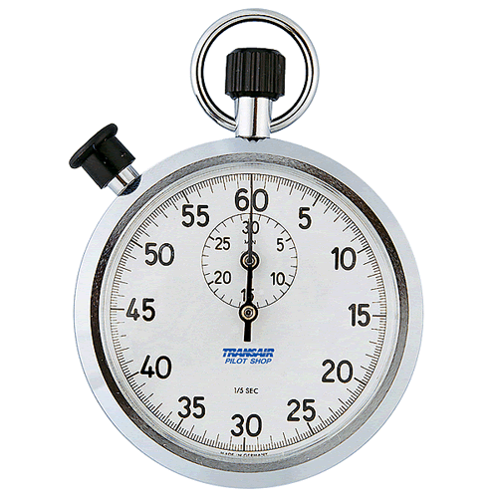
Time’s Up!
About your speaker:
Name: Emrah Özcan
Institution: Yıldız Technical Uni.
Social Media: @mrhzcn
Quick bio: Research Assistant
@Yıldız Technical University, ELT Dept.
http://avesis.yildiz.edu.tr/eozcan/

